Slide 1
Ensemble Learning
WK DSS 220, Module 3, Lesson 3
Notes:
Welcome to this lecture on ensemble decision tree algorithms. We’ll mainly cover Random Forests, but I’ll also briefly go over Boosted Decision Tree ensembles.

Slide 2
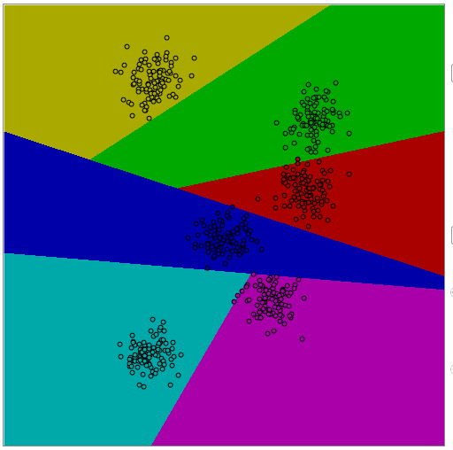
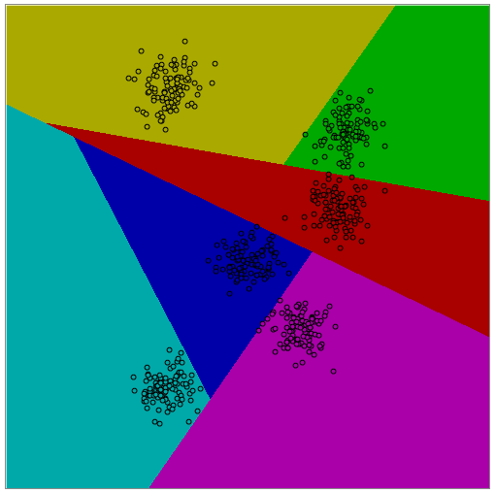
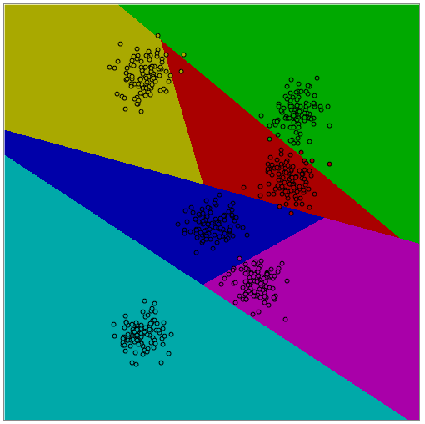
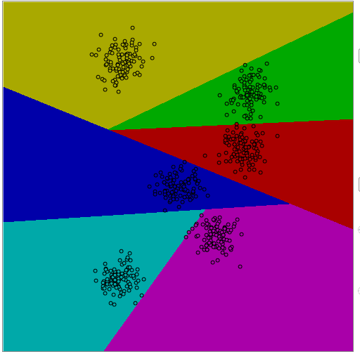
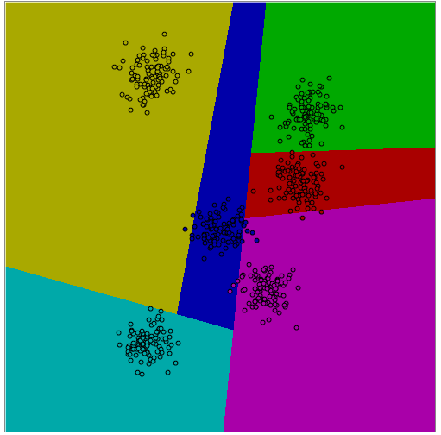
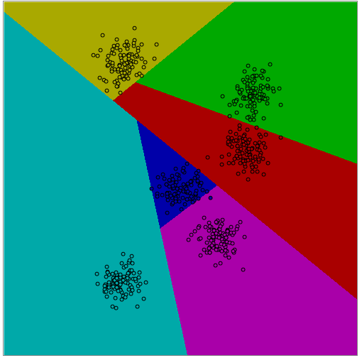
High Variance
Notes:
Previously we talked about how decision trees were low biased because they don’t make any assumptions of the underlying distribution. So they do a pretty good job on average, of guessing correctly.
The problem is that given a certain training dataset, there are many ways to grow a tree.

Slide 3
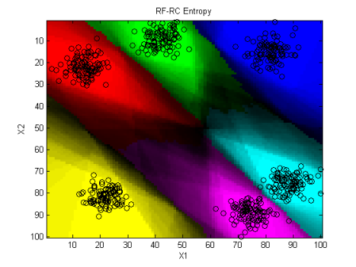
Ensemble Learning
Notes:
Combining the outputs of multiple decision trees gives us the largest average value. Through voting, you get not just the overall prediction, but a pseudo-certainty in the form of the vote count.
Let’s say for a given point, the answer was class A. But the vote count was 51/100. For a 2-class problem, we can say that 51% of the trees voted for class A. So the random forest classifier is not very certain of it’s guess.
Let’s go over the random forest algorithm in detail to discuss other features.

Slide 4
Random Forest Classifier
For each tree
Randomly choose a certain subset N of observations (with replacement)
For each decision node
Randomly choose a subset of variables X
For each variable x in set X
Try all training values as a decision threshold
Choose the variable and threshold that best splits the data
Iterate through each child leaf
If child leaf only contains observations from one class, stop
Notes:
This is the pseudo-code for the Random Forest Algorithm. Let’s go over it a line at a time.

Slide 5
Random Forest Classifier
For each tree
Randomly choose a certain subset N of observations (with replacement)
For each decision node
Randomly choose a subset of variables X
For each variable x in set X
Try all training values as a decision threshold
Choose the variable and threshold that best splits the data
Iterate through each child leaf
If child leaf only contains observations from one class, stop
Notes:
This is the pseudo-code for the Random Forest Algorithm. Let’s go over it a line at a time.

Slide 6
Random Forest Classifier
For each tree
Randomly choose a certain subset N of observations (with replacement)
For each decision node
Randomly choose a subset of variables X
For each variable x in set X
Try all training values as a decision threshold
Choose the variable and threshold that best splits the data
Iterate through each child leaf
If child leaf only contains observations from one class, stop
Notes:
This is the pseudo-code for the Random Forest Algorithm. Let’s go over it a line at a time.

Slide 7
Random Forest Classifier
For each tree
Randomly choose a certain subset N of observations (with replacement)
For each decision node
Randomly choose a subset of variables X
For each variable x in set X
Try all training values as a decision threshold
Choose the variable and threshold that best splits the data
Iterate through each child leaf
If child leaf only contains observations from one class, stop
Notes:
This is the pseudo-code for the Random Forest Algorithm. Let’s go over it a line at a time.

Slide 8
Random Forest Classifier
For each tree
Randomly choose a certain subset N of observations (with replacement)
Variables
Subset N
Observations
Notes:
The Random Forest grows each decision tree on a different subset of observations. Usually, for any given tree, 70% of observations are randomly chosen. The remaining are then considered “out-of-bag”.

Slide 9
Random Forest Classifier
Variables
Subset N
Variable Subset x
Node
Observations
Notes:
Within this subset of observations, we grow the decision tree one node at a time.
For each node, we don’t look at all the variables to choose the best one for splitting the data. Instead, we choose a random subset of the set of variables and then determine which of those variables is best for splitting the data.
Usually subset x of variables is the square root of the total number of variables.
This double-selection process, once per tree of observations and again at each node for variables allows decision trees more opportunities to be different from each other. When you have de-correlated trees, they each offer a different view of the decision space. The idea is that many different views give a better overall idea of where the true decision boundaries lie.

Slide 10
Random Forest Classifier
Node
Variable x < Threshold_t
Variable x >= Threshold_t
Child Node
Child Node
Notes:
For a particular tree, we start at a root node. This node has a certain mix of observations from each class.
The random forest algorithm will go through each variable and every available value to find the one that splits the data best. “Best” means splitting the data so that each child has the most possible observations from the main class.
You iterate until you get a child node that is entirely of a single class – that is your leaf node.

Slide 11
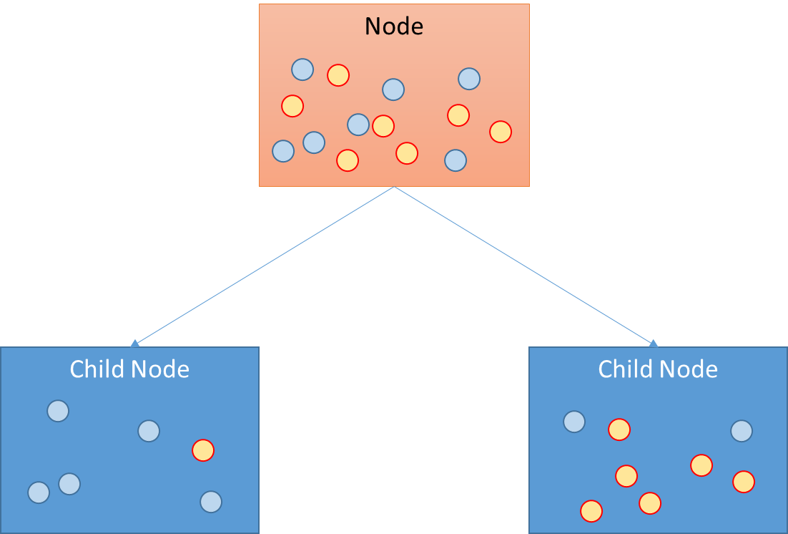

Gini Gain
Gini Index
C = number of classes
p(i) = probability of choosing class i
$$G= \sum_{i=1}^{C}{p\left(i\right)∗((1−p\left(i\right))}$$
$$Gini Gain=G_{parent}−\sum_{j=1}^{\# of Children}{{w_{j}G}_{j}}$$
(w_{j} = weight for child node j)
Notes:
There are a few different ways to measure how good a split is. “Gini” importance is one of them.
Gini uses the probability of choosing class i in a given set (or node). Then 1-p(i) is the probability of choosing one of the other classes.
Gini=1 means that classes are randomly distributed
Gini = 0.5 means both classes are equal
Gini = 0 means that there is only one class
We determine the gain in Gini purity by taking the Gini importance from the parent and subtracting that of each of the children.

Slide 12
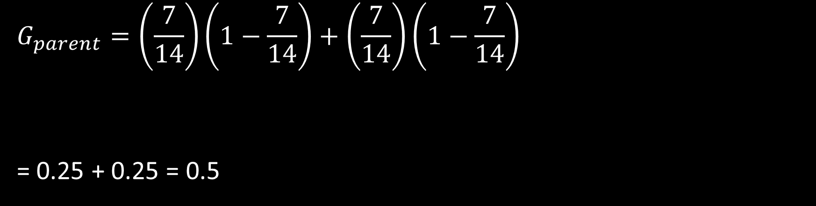
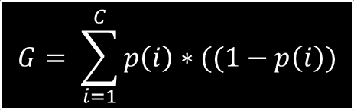
Parent Impurity
$$G= \sum_{i=1}^{C}{p\left(i\right)∗((1−p\left(i\right))}$$
Node
$$G_{parent}=\left(\frac{7}{14}\right)\left(1−\frac{7}{14}\right)+\left(\frac{7}{14}\right)\left(1−\frac{7}{14}\right)$$
= 0.25 + 0.25 = 0.5
blue
yellow
Notes:
Let’s work through an example.
At this node, there are 7 yellow nodes and 7 blue nodes. Let’s calculate the Gini Index for this parent node.

Slide 13
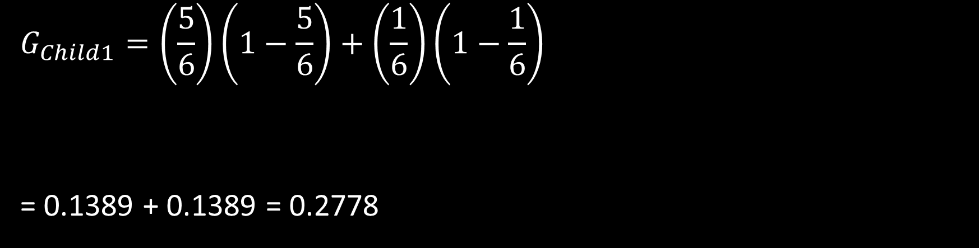
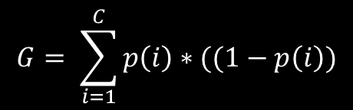
Child1 Impurity
Child Node
$$G= \sum_{i=1}^{C}{p\left(i\right)∗((1−p\left(i\right))}$$
$$G_{Child1}=\left(\frac{5}{6}\right)\left(1−\frac{5}{6}\right)+\left(\frac{1}{6}\right)\left(1−\frac{1}{6}\right)$$
= 0.1389 + 0.1389 = 0.2778
blue
yellow
Notes:
Suppose we use a decision threshold that creates 2 children. This is Child 1

Slide 14
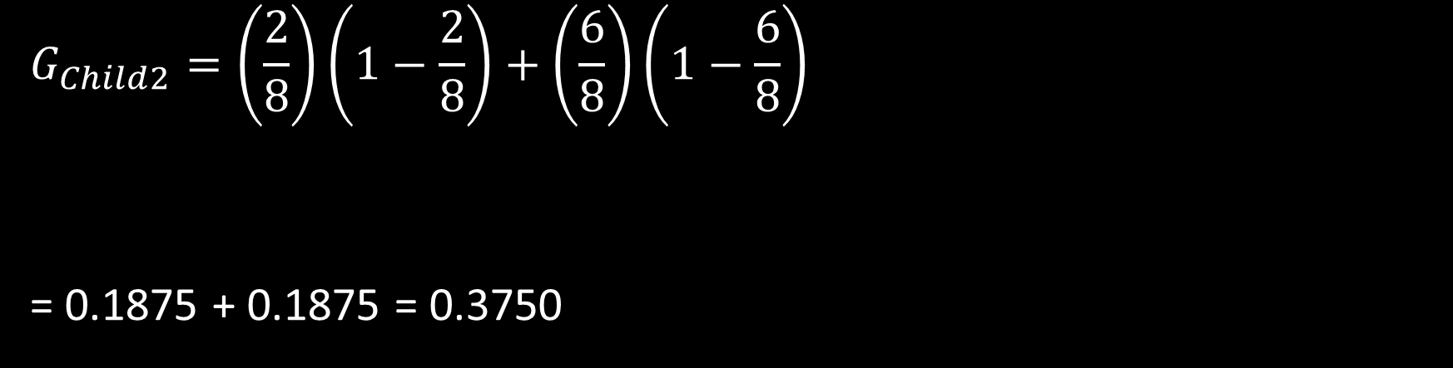
Child2 Impurity
Child Node
$$G= \sum_{i=1}^{C}{p\left(i\right)∗((1−p\left(i\right))}$$
$$G_{Child2}=\left(\frac{2}{8}\right)\left(1−\frac{2}{8}\right)+\left(\frac{6}{8}\right)\left(1−\frac{6}{8}\right)$$
= 0.1875 + 0.1875 = 0.3750
blue
yellow
Notes:
Similarly for the 2nd child, the Gini Index is 0.3750

Slide 15
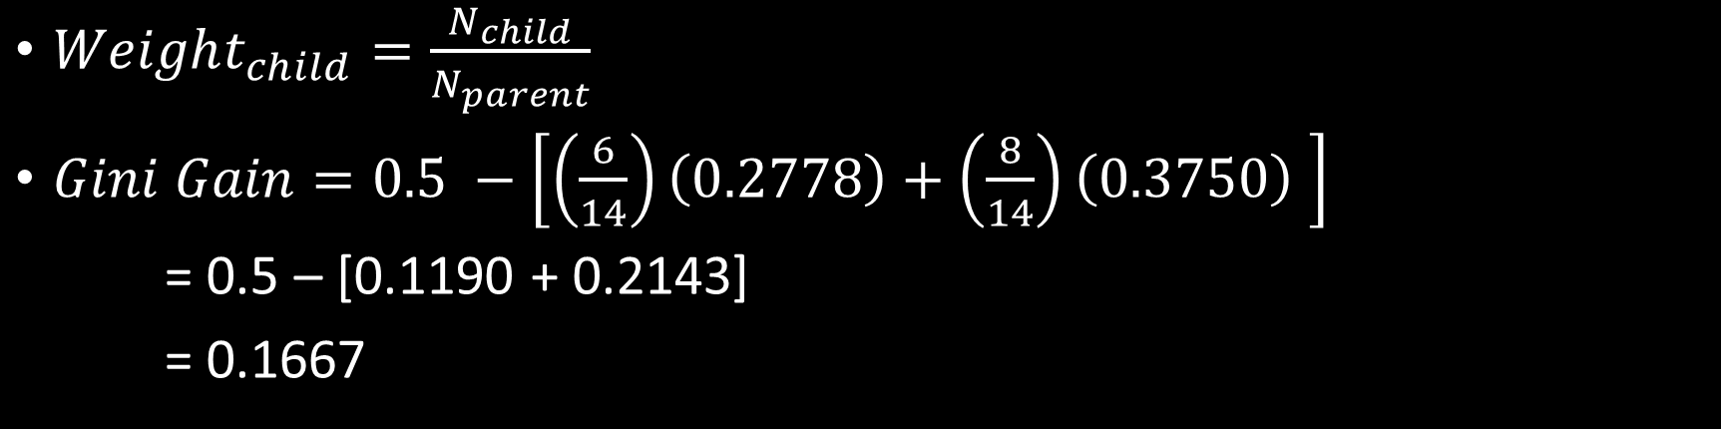
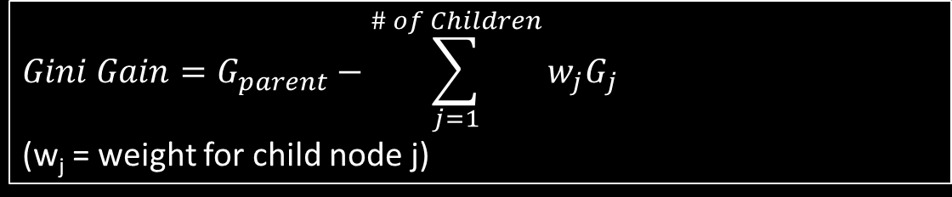
Gini Gain
$$Gini Gain=G_{parent}−\sum_{j=1}^{\# of Children}{{w_{j}G}_{j}}$$
(w_{j} = weight for child node j)
$Weight_{child}=\frac{N_{child}}{N_{parent}}$
$Gini Gain=0.5 −\left[\left(\frac{6}{14}\right)\left(0.2778\right)+\left(\frac{8}{14}\right)\left(0.3750\right) \right]$
= 0.5 – [0.1190 + 0.2143]
= 0.1667
Variable and threshold with largest Gini gain is kept for this node
Notes:
The Gini Gain is the different between the Gini Index of the parent and the total of the Gini Indices for the children
There is one extra step. You need to normalize each child weight by dividing the total number of observations in each child node by the total number of observations in the parent node. This prevents a very small child node from being overtaken by a larger sibling.

Slide 16

Information Gain
Can also use Entropy instead of Gini
Entropy:
$H\left(S\right)=−\sum_{i}{P\left(i\right)\log_{2}{P(i)}}$
Information Gain:
$Information Gain \left(T,X\right)=Entropy\left(T\right)− \sum_{Child}{\frac{s_{child}}{T}Entropy(child)}$
T = number of observations in the parent node
S_child = number of observations in each child node
Notes:
Another metric that is more classically known is Entropy and Information Gain. Entropy is similar to Gini but uses a logarithmic normalization of the class probability.
If you have a pure node, p(i) =1, so log(1) =0. Therefore 0 Entropy means a pure node, and 1 entropy means all classes are equally represented.
The information gain is then the parent entropy minus the normalized entropies for each child.

Slide 17
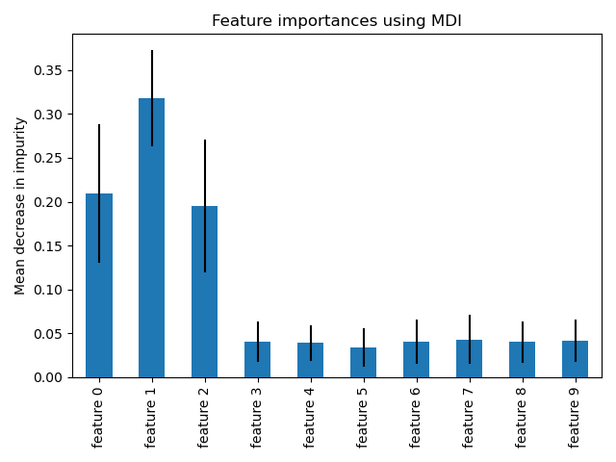
Variable Importance
Average Gini-based information for each variable for each tree
Plot = variable importance
Watch out:
Doesn’t deal well with correlated variables
Can show bias toward high-cardinality (many unique values) variables
More advanced feature permutation
Overcomes Gini weaknesses
More computationally heavy
Notes:
Going back to Gini (this applies to entropy too), the algorithm will split a given node for all values of each variable in the random subset. It will record the Gini Gain for the chosen threshold and variable. You can record how well a variable did in splitting a node by averaging the Gini Gain for each variable in the dataset over all the nodes and all the trees. The resulting plot gives a pseudo-variable importance plot showing which ones are better at splitting classes than others.
There are a few things you need to watch out for (read bullets)
There are more advanced methods out there to account for weaknesses from Gini based variable importance.

Slide 18
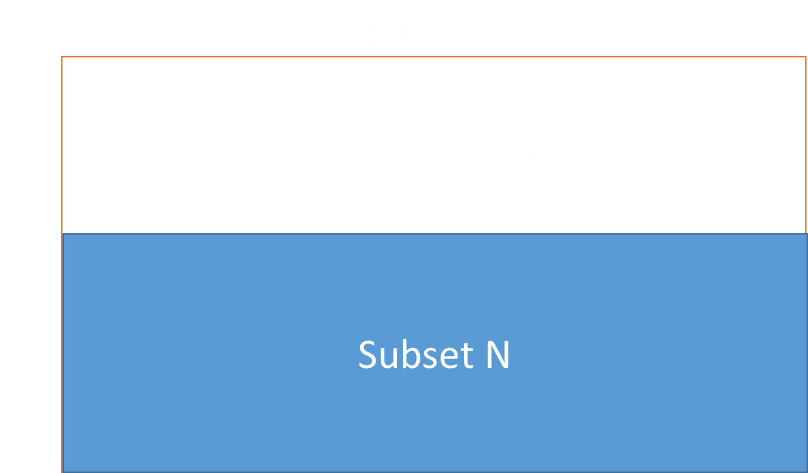
Out-Of-Bag Error
Decision Tree grown with subset of observations
Observations left out = “Out Of Bag” (OOB)
Test decision tree on OOB
For observation X
All trees where X was OOB vote
Majority vote = prediction
Calculate overall error for all OOB observations
Notes:
Remember that for a given tree, only a subset of observations were used to train the tree. The remaining “out of bag” observations can now serve as a validation set to see how well the tree did.
So for a given observation X, find all the trees where the observation was out of bag and let those trees vote on the predicted value.
It turns out that using out of bag estimate on of accuracy serves as a pretty good predictor of how well the random forest will do for an unknown test set of data.

Slide 19
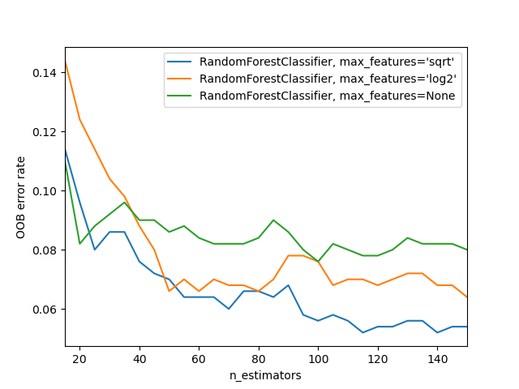
Number of Trees
How big a forest do you need?
Try different options
Plot OOB Error to see inflection point
Notes:
How many trees do you need? I like using an iterative graph like this. You’ll usually get to a steady state after which error doesn’t decrease much.
One side thing to note here is that RF is very resistant to overfitting. So growing a larger forest than needed won’t hurt except costing computation time

Slide 20
Settings Trade-off
Number of Trees
n_estimators
Tree Length
max_depth
OOB Percentage
max_samples
Number of features per node
max_features
Notes:
Too many trees wastes resources. Too few doesn’t create a good estimate
Usually grow to full size, but can make it shorter. Shorter trees may help with generalization
By default, trees are grown to full length. This is to maximize de-correlation between trees. However, you can choose to grow smaller trees.
If you have a large number of classes, then growing a shorter tree might make sense. Otherwise, some trees might have hundreds of levels.
Greater OOB percentage leads to better validation results, but poorer training as you have less training observations
How many variables you can leave out of bag depends on how large your training set is. If you have a small training set, you don’t want to leave too many observations out of bag because you’ll need them to grow a good decision tree.
Having a larger number of features leads to less tree randomness
How large a subset of variables do you want to choose for each node-split.
If you have just a few variables in your dataset, then you might need a larger percentage. Otherwise you might get 2-3 in a subset.
On the other hand, if you’re looking at raw time series or image data, then you have hundreds or thousands of variables, so you can choose a smaller percentage as the subset size.

Slide 21
Boosted Trees
Grow short decision tree or stump
Misclassfiied observations more likely to be used to grow next tree
Trees that do a better job get more weight or “say” in final vote
Repeat N times
Calculate training data error
Calculate training data error
Notes:
Lastly, let’s talk about boosted decision trees. An algorithm that was very popular a while back was XGBoost or Extreme Gradient Boosting. I’m going to show you a simpler version here, but the concept is very similar.
First off, you grow a very simple decision tree, or even just one node split, called a “decision stump”.
Calculate the training error
Then create 2 types of weights
For the first, find all the observations that the decision stump did poorly on. Give them a higher weight.
Higher weight observations make them more likely to be chosen to grown the next decision tree
2nd, give decision trees that do well a higher tree-weight.
Then use the weighted probabilities of the observations to choose a subset to grown the next decision tree. Repeat as desired.
By doing this method, each subsequent tree focus more on observations that are harder to classify.
If a tree does a good job classifying “harder” observations, then it gets a larger tree-vote.

Slide 22




Boosted Trees
. . .
$$w_{1}$$
$$w_{2}$$
$$w_{3}$$
$$w_{4}$$
Final Vote
Notes:
Then do a weighted average. Trees that did a poor job get a smaller weighted vote. Those that did better on harder to classify observations get a bigger vote.
The final weighted vote then becomes the Boosted Ensemble vote.

Slide 23
Other Resources
General Boosting Explained:
https://youtu.be/MIPkK5ZAsms
AdaBoost Explained:
https://youtu.be/LsK-xG1cLYA
Gradient Boosting Estimation:
https://youtu.be/3zEqUSf5duw

